Slide 1

DYNAMIC IS CARTOGRAPHY
Hackathon CGI

Slide 2
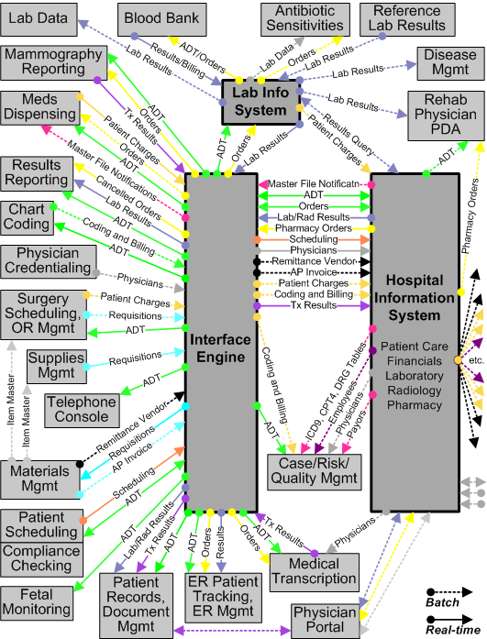

The world before “Dynamic IS Cartography” (DISC) ?
Static
Never up to date

Slide 3
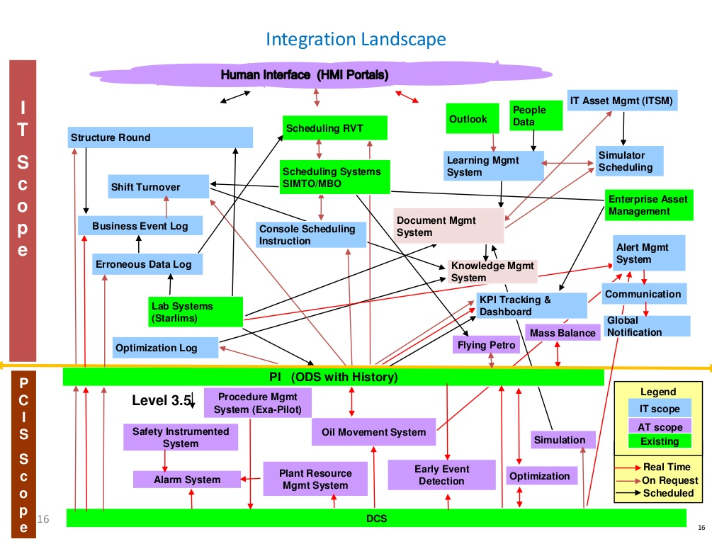
The world before “Dynamic IS Cartography” (DISC) ?
Time consuming to maintain

Slide 4
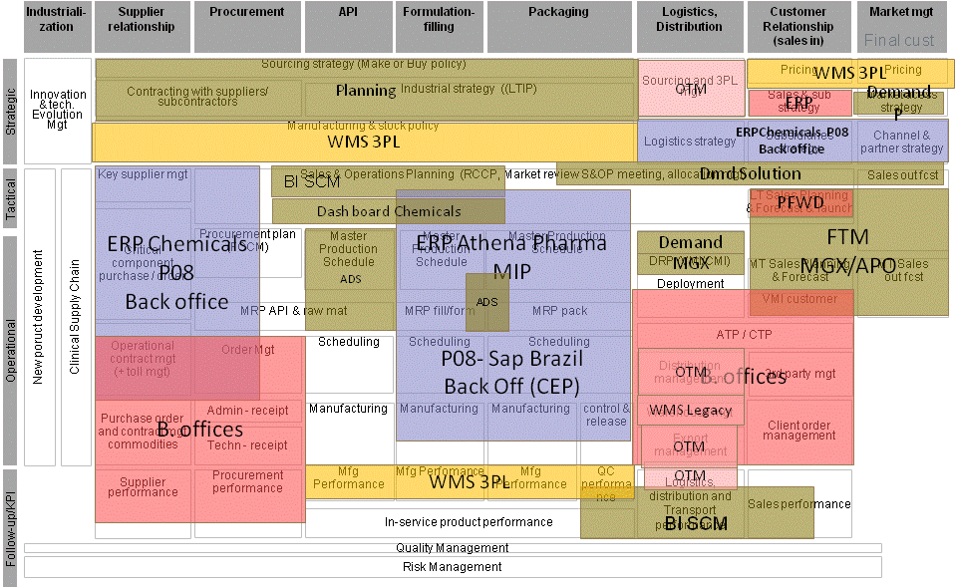

The world before “Dynamic IS Cartography” (DISC) ?
Unreadable

Slide 5
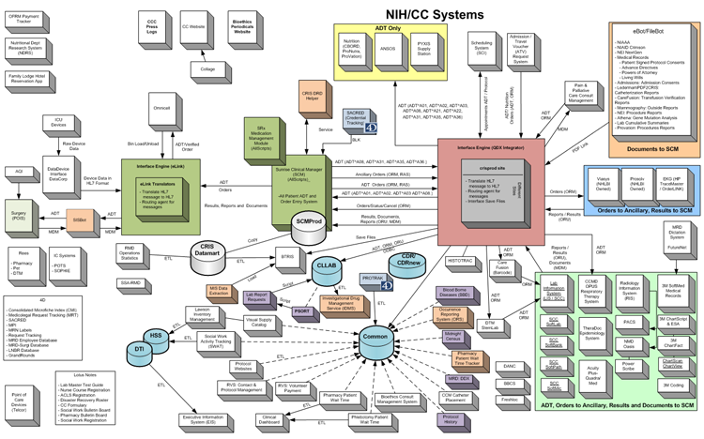
The world before “Dynamic IS Cartography” (DISC) ?
Ugly

Slide 6

What is “Dynamic is Cartography” ?
A tool to visualize applications architecture (applications and integration between applications) over time (as-is, To-Be) in a friendly way (similar to Google Map where level of details shown depends on zoom level).

Slide 7








Summary requirements
Drilldown / zoom in/out functionality, possibility to move around the drawing by dragging with the mouse (similar to Google Map)
4 levels each one with more details
The tool should be on a server accessible through a webbrowser
It should be easy to maintain without programming
Possibility to display several versions :
As-is, To-be and intermediate states (transitory 1, transitory 2…)
Possibility to position elements of the drawing manually
Legend for each level
Link between the drawings and a control table/database controlling what is shown on drawings

Slide 8
The 4 levels detailed
0
1
2
3
Level 2 : more information on interfaces summary (information of interfaces content on arrows), more information on application content (processes covered by each application - optional)
Level 0 : all application
Level 1 : all application and summary links between applications : 1 arrow representing interfaces inbound (1 arrow) / outbound (1 arrow) grouping
Level 3 : details of all interfaces (one arrow per interface)

Slide 9

Level 0
Application details
Application’s name
Business description with color coding by business areas of the application
Name of the application & application shown depending on the version selected controlled by data entered in the control table
Link details
No link
Legend detail
Description of color code
Link in every name to increase details (for details of the legend, go to page 20)
Optional
Possibility to have a background image representing the process map to map applications to the main processes

Slide 10
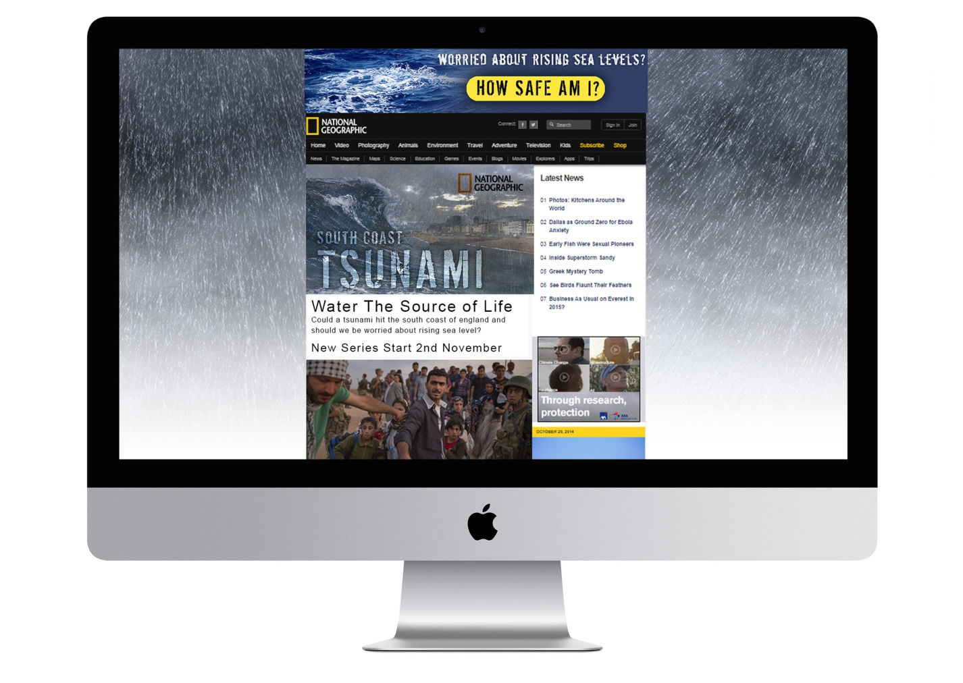

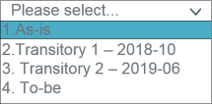
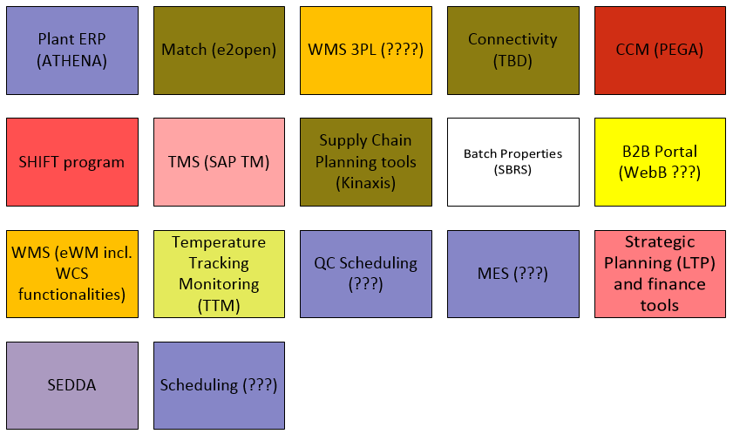
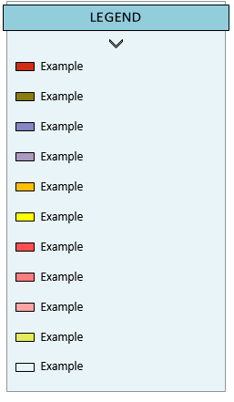

Level 0
Share button
Possibility to display several versions
Legend 1
Describes color code
Button to position elements of the drawing manually

Slide 11

Level 0 – Example 1
‘’To-be’’ version

Slide 12

Level 0 – Example 2
Plant ERP (ATHENA)
TIP
WMS 3PL
Connectivity (TBD)
APO
ADS
SARR
M²
Batch Properties (SBRS)
B2B Portal (WebB)
WES
Temperature Tracking Monitoring (TTM)
SCP Tool
MES (???)
Strategic Planning (LTP) and finance tools
‘‘As-is’’ version
SEDDA
Scheduling (???)

Slide 13
Level 1
Application details
Application’s name (same as level 0)
Business description with color coding by business areas of the application (same as level 0)
Name of the application & application shown depending on the version selected controlled by data entered in the control table (same as level 0)
Link details
Links between applications: 1 arrow representing interfaces inbound (1 arrow) / outbound (1 arrow) grouping
Color code on the arrow to distinguish the need or not of an Integration Platform (information contained in the control table)
Legend detail
Description of color code
Link in every name to increase details (for details of the legend, go to page 20)

Slide 14
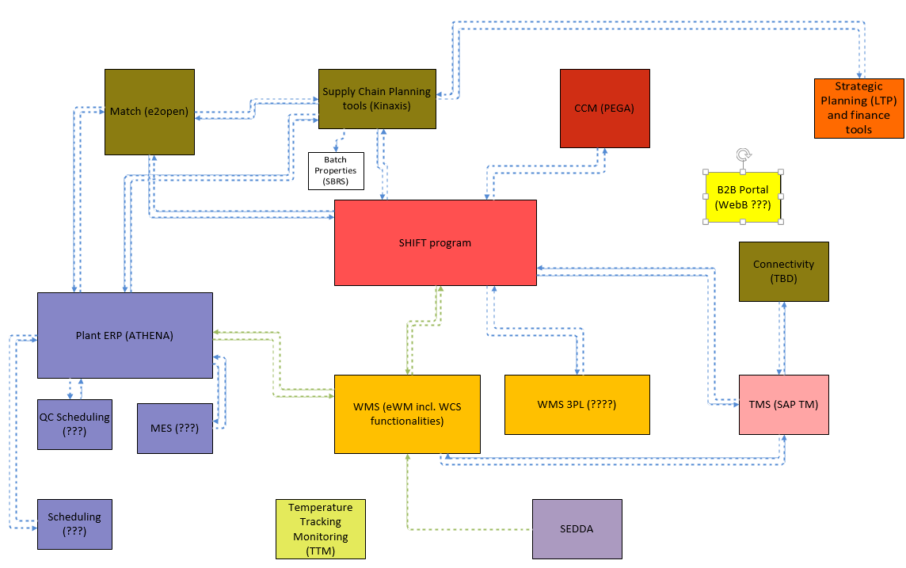
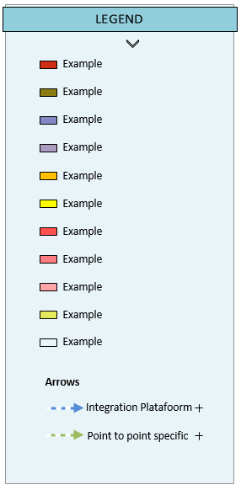
Level 1 – Example 2
Legend 2
Describes arrows color code

Slide 15
Level 2
Application details
more information on application content (processes covered by each application - optional)
Link details
Link between apps : more information on interfaces summary (information of interfaces content on arrows),

Slide 16
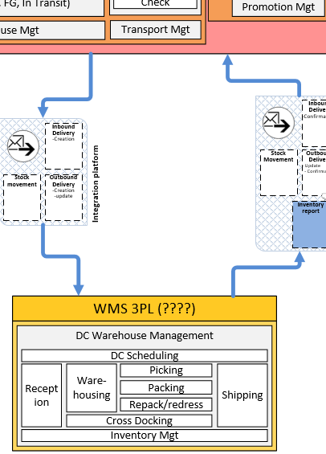

Level 2 – Details of an interface line
The type of frame defines the type of data
The image defines the type of update

Slide 17
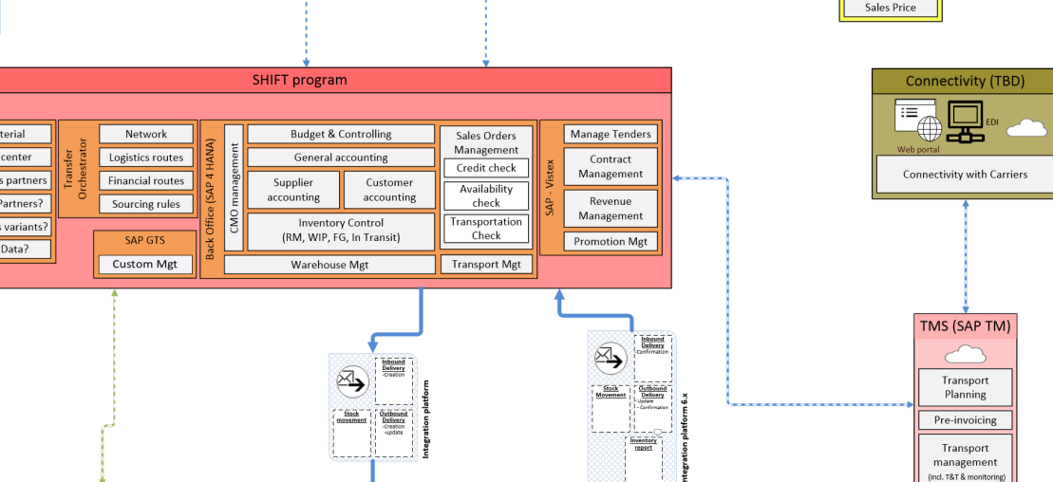
Level 2 – Another view
Scroll to any direction

Slide 18
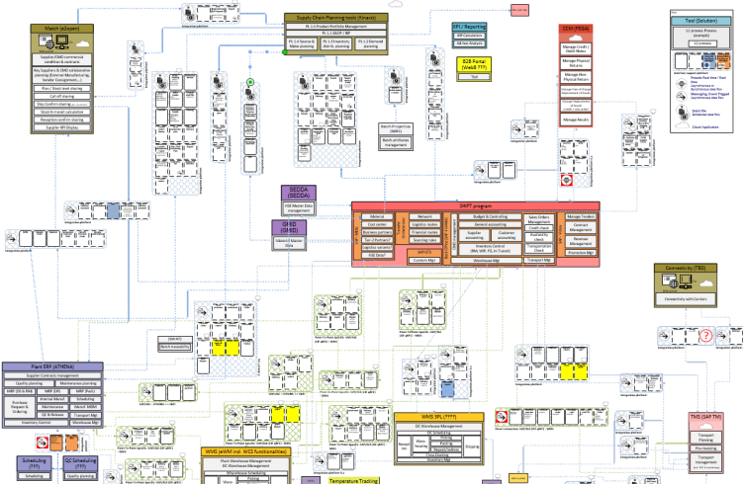
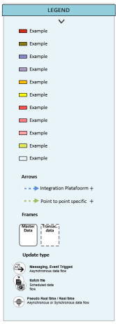
Level 2 – Overall view
This view is not displayed as such, because if you zoom out you will go to above level

Slide 19
Level 3
Application details
Process level 2 (show activities) within the application boxes.
Link details
A link for each Business Object that connects apps (details of all interfaces : one arrow per interface)
Color code on the arrow to distinguish the need or not of an Integration Platform (information contained in the control table)
Legend detail
Description of frame patrons (Type of data)

Slide 20
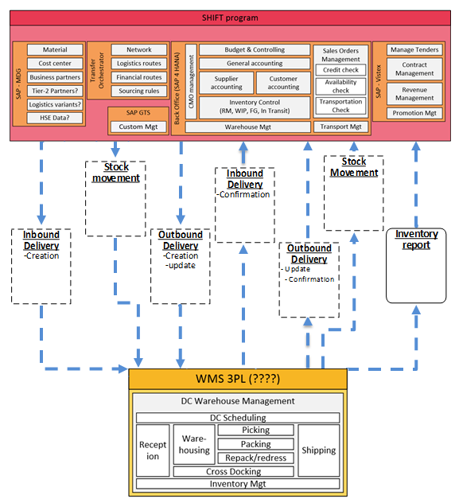
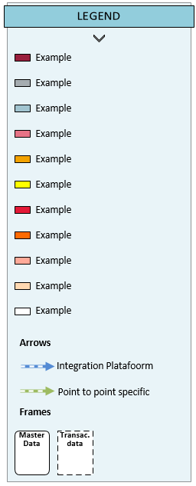
Level 3
Hypertext link (configurable)
-
If you click, you will see documentation repositories

Slide 21
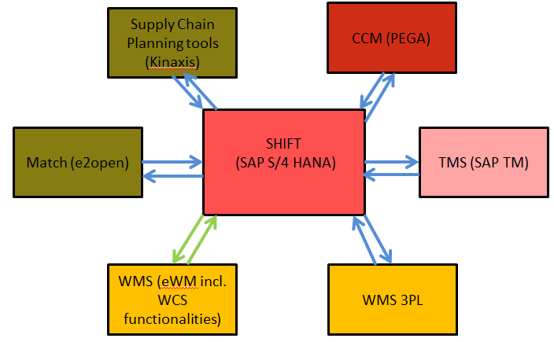
Additionnal functionnality : zoom on one application and its interfaces
If you click one app box, it will be centered and it will show only the connected application to this one (with arrow lines) and not the other ones that are not connected

Slide 22
Additionnal functionnality : zoom on one interface set between applications
SHIFT
(SAP S/4 HANA)
Match (e2open)
If you click one interface, on level 1 or 2-> all flows between the 2 systems connected by the arrow on which the user clicked

Slide 23
Table
Information about interface
Applications vs Process
3
Interface ID vs Version
2
4
Applications vs Versions
1
5
Application’s description
5 TYPES
OF TABLE

Slide 24

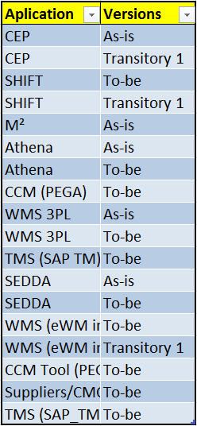
Tables – Application vs Versions
Plant ERP (ATHENA)
Match (e2open)
WMS 3PL
Connectivity (TBD)
CCM (PEGA)
SHIFT
(SAP S/4 HANA)
TMS (SAP TM)
Supply Chain Planning tools (Kinaxis)
Batch Properties (SBRS)
B2B Portal (WebB)
WMS (eWM incl. WCS functionalities)
Temperature Tracking Monitoring (TTM)
QC Scheduling (???)
MES (???)
Strategic Planning (LTP) and finance tools
SEDDA
Scheduling (???)

Slide 25
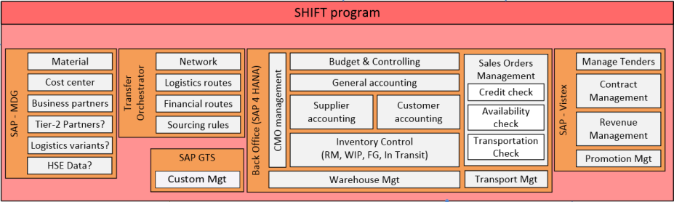
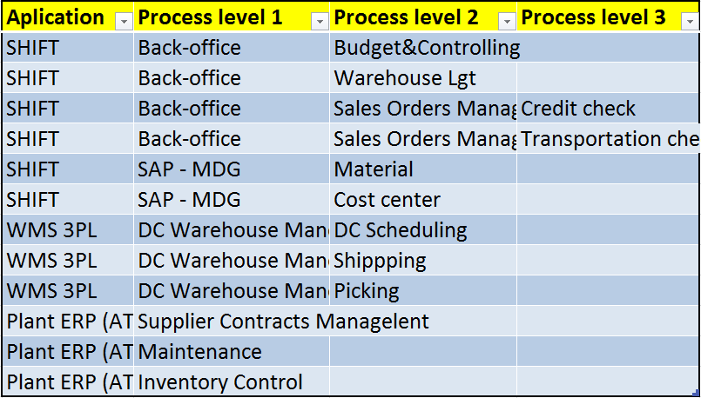
Tables – Application vs Process

Slide 26

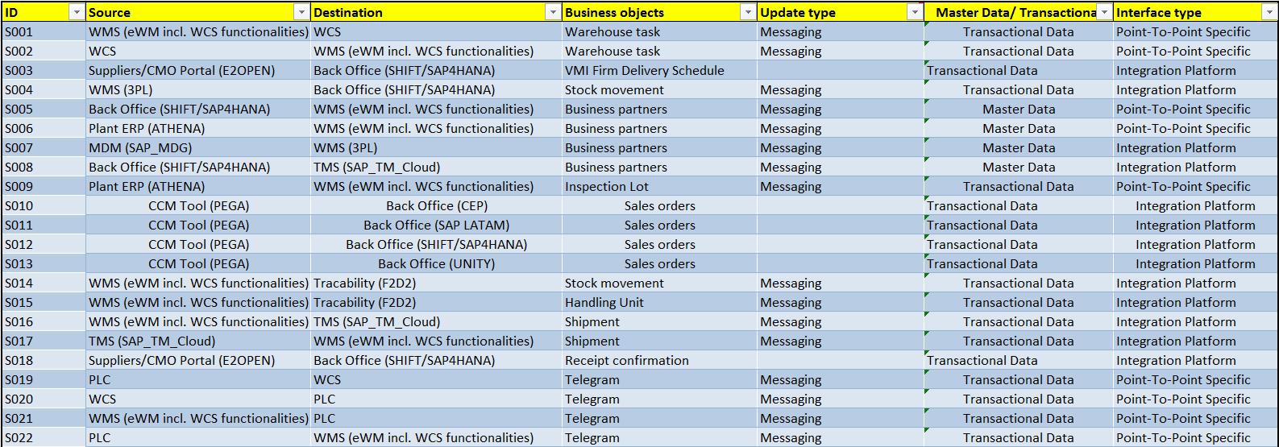
Tables – Information About Interface
ID = S004

Slide 27
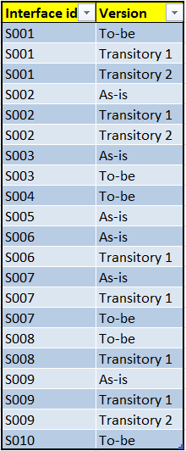
Tables – Information About Interface

Slide 28
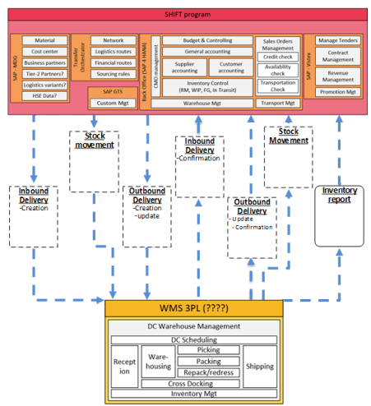

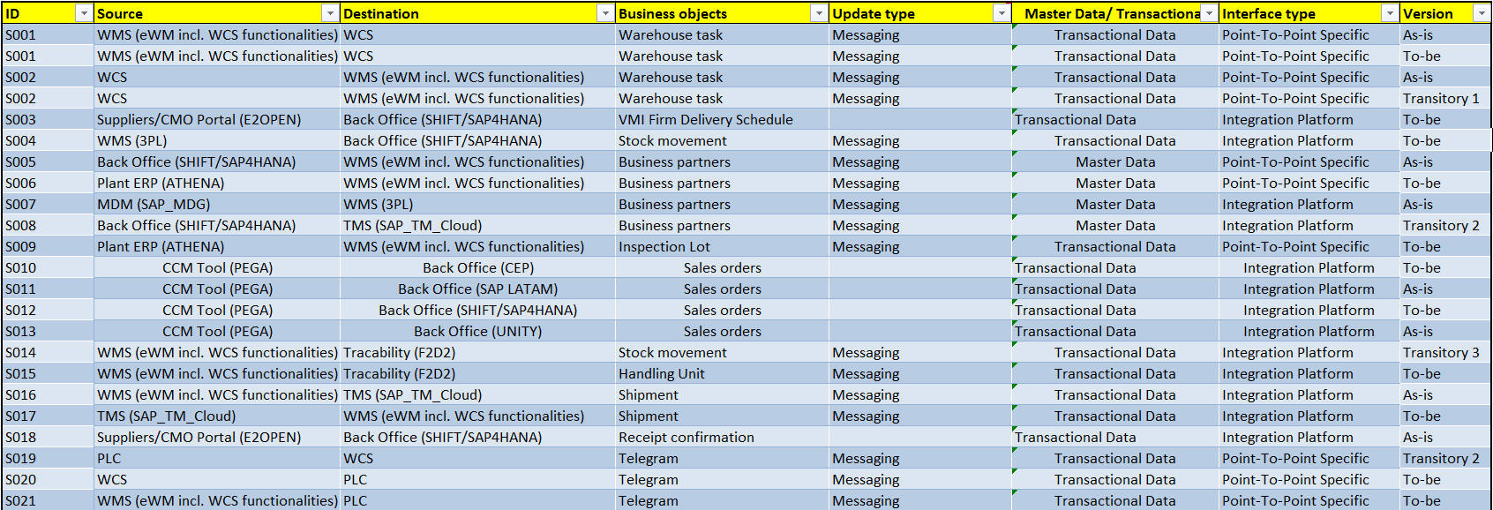
Tables – Information About Interface
ID = S004

Slide 29
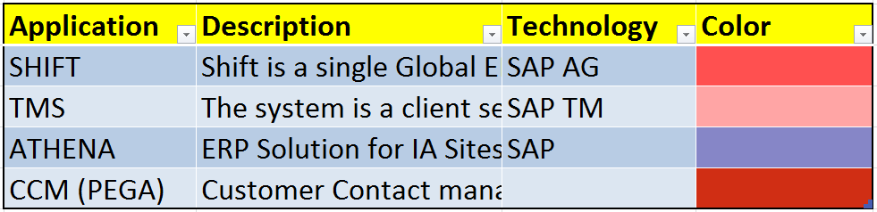
Tables – Applications Description
Plant ERP (ATHENA)
Match (e2open)
WMS 3PL
Connectivity (TBD)
CCM (PEGA)
SHIFT
(SAP S/4 HANA)
TMS (SAP TM)
Supply Chain Planning tools (Kinaxis)
Batch Properties (SBRS)
B2B Portal (WebB)
WMS (eWM incl. WCS functionalities)
Temperature Tracking Monitoring (TTM)
QC Scheduling (???)
MES (???)
Strategic Planning (LTP) and finance tools
SEDDA
Scheduling (???)

Slide 30
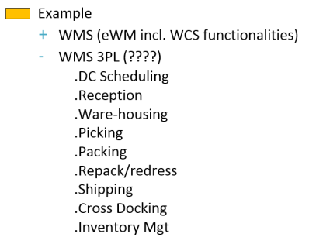
Legend
The legend can be minimized
If you click the name of the color code it will show more details:
Apps with that color
Level 2 of the app selected
.Security Gateway to Cloud (Layer7)
.Data Hub
.TIBCO
. Business Transaction Monitoring Tool
If you mouseover the ‘+’ sign in the arrow section you will see details

Slide 31
Optional functionnality

Slide 32
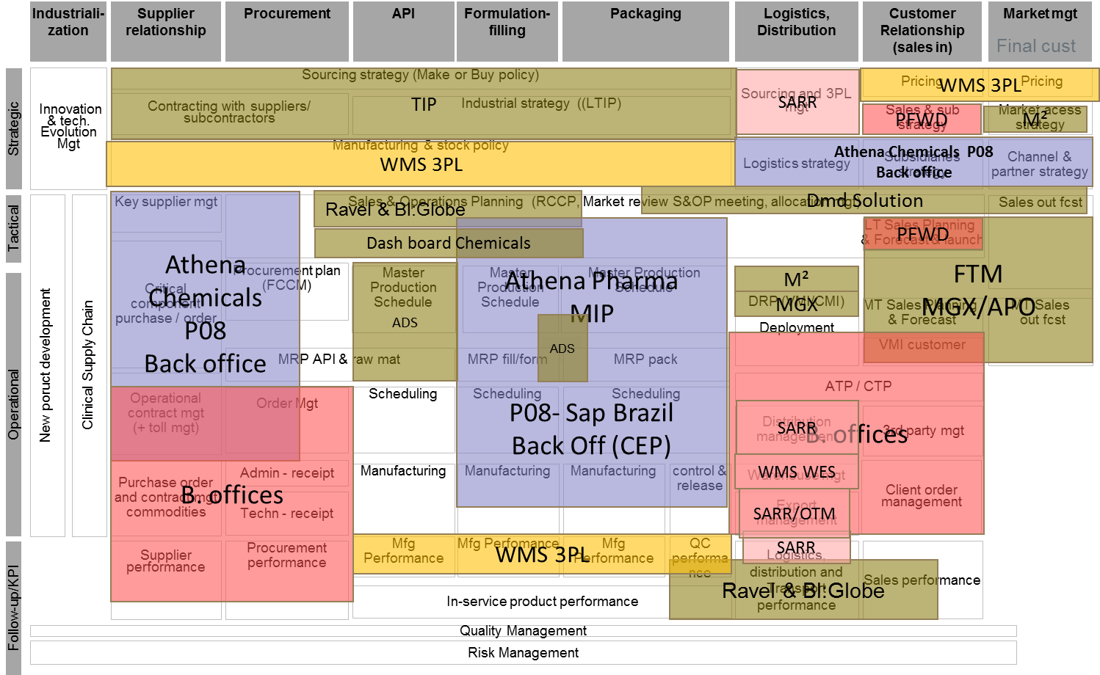
Optional - Level 0 –– With process map behind

Slide 33
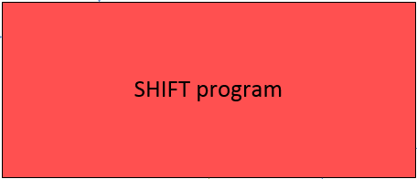
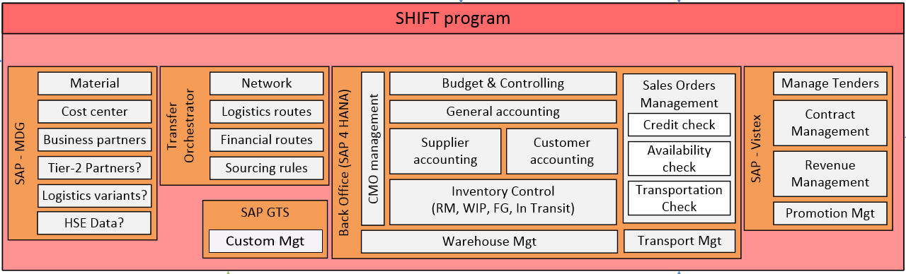
Optional – show process content within application for level >= level 1
If you double-click the app box in the level 1 you will get to the level 2 centered in that app

